Slide 1
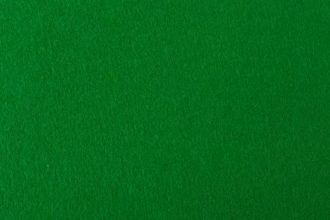
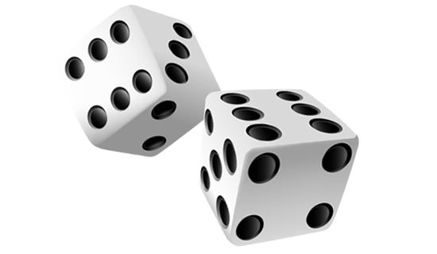
The Gambler

Slide 2
Team Members
Chase Keller
Joshua Schmitz
Colston Erwin

Slide 3
Problem
Downtime between classes with nothing to do, everything that you would normally do during this time is completed and you need a game to pass some time while you wait.

Slide 4
Solution
A fun, no money stake gambling game. With our project “The Gambler” you can pass time by playing an assortment of games being Slot Machine, Roulette Wheel, or even Black Jack.

Slide 5
Features
Main Menu 100%
Slot Machine 75%
Roulette Wheel 95%
Black Jack 90%

Slide 6
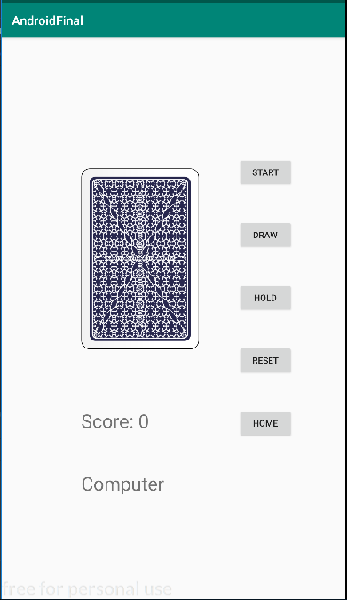
Black Jack
The black jack game you play against the computer to see who can get the closest to 21!

Slide 7
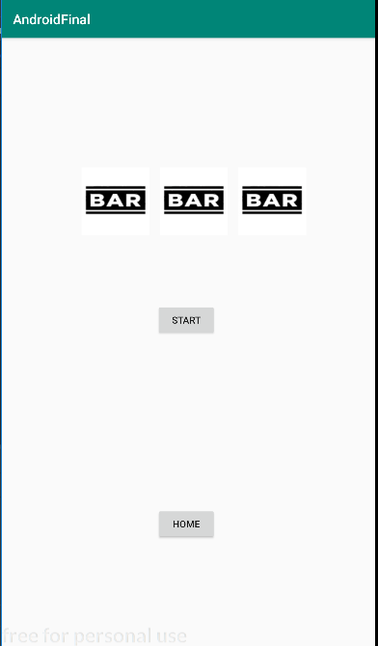
Slot Machine
In the Slot Machine portion of the app you have to spot the spinning wheels to land on all three to get the big payout!

Slide 8
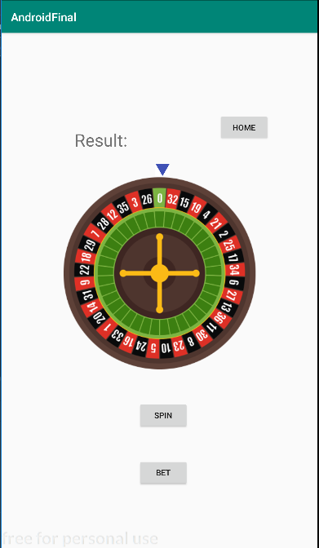
The Roulette Wheel
The roulette wheel lets you place bets on where you think the wheel will stop and depending on your bet you can win Big!

Slide 9
Occurred Problems
We had a few issues that challenged us when making the final project.
Merge Conflicts
Intents and Fragments
Other small issues (i.e. crashes, loops, setup, etc.)
Animation
Persistent Memory

Slide 10
Improvements
Money or Point system, for now we wanted to make something fun that gives no stress to the user when playing but a point system across all the games would be fun!
More variety games, such as horse racing, poker, etc.
Redesign activities with images and colors to make the games better to look at while playing them to keep the user more engaged.

